Slide 1
“One book, one pen, one child and one teacher can change the world.”
- Malala Yousafzai

Slide 3
We are ‘Award Winning’

Slide 4
Uniform
PE Kits
Attendance
Behaviour Expectations & Rewards
Breakfast Club
After School Clubs
Wraparound
Reading
Mathematics
Homework

Slide 5
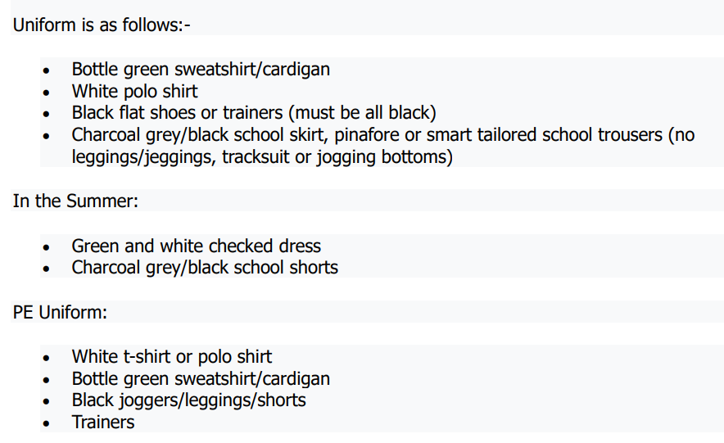
We provide all children with a Broadway Bottle…
Our school operates a strict no-jewellery policy.
Uniform items can be purchased online at www.totalsport-ne.co.uk or in person at Total Sports North East, Hendon Road, Sunderland SR1 2JD.

Slide 6
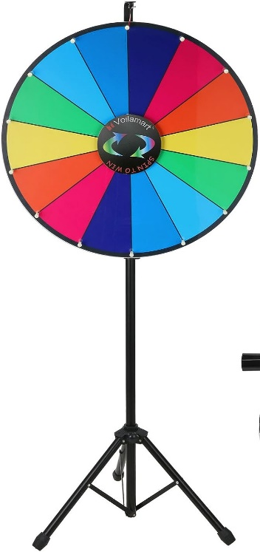
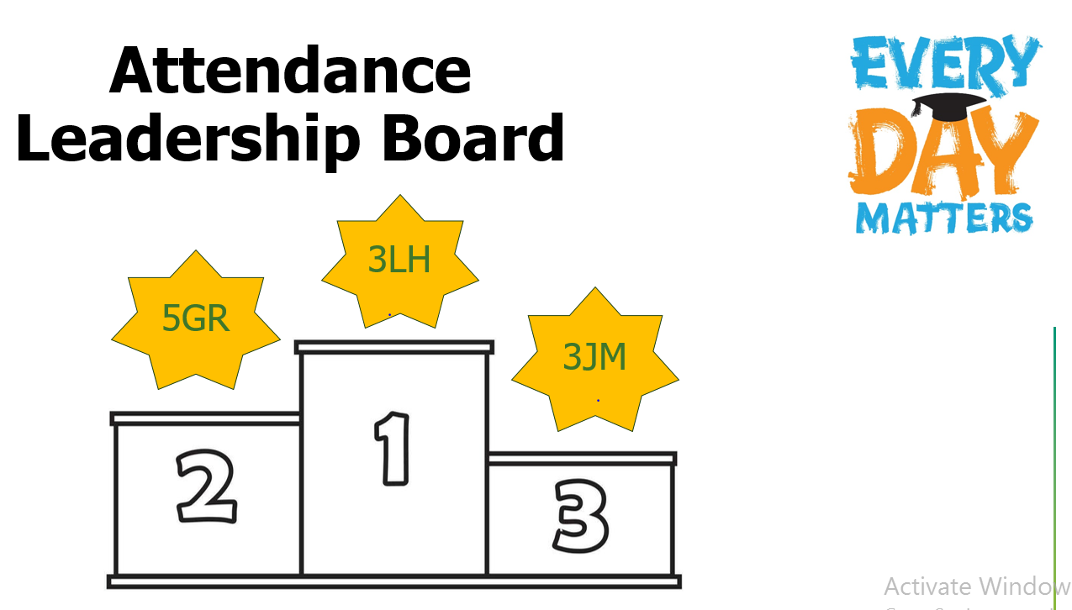
Attendance
Supporting and promoting regular school attendance is a parent’s responsibility. Please let us know if your child will be absent from school – absence should be reported to the school office (0191 528 3058).

Slide 7
Behaviour Expectations
At Broadway Junior School we ensure that every member of the school community feels valued and respected, and that each person is treated fairly and well. The school Behaviour Policy is therefore designed to support the way in which all members of the school can work together. It aims to promote an environment where everyone feels happy, safe and secure.

Slide 8
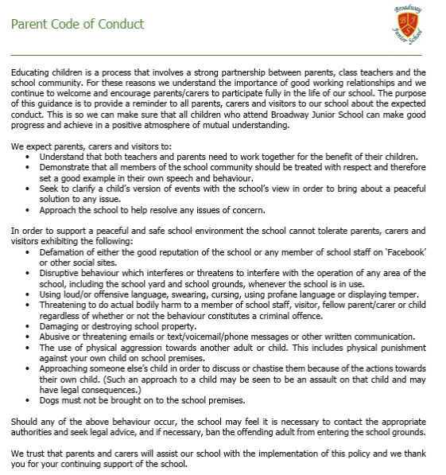
We value mutual respect; we’re here to help.

Slide 9
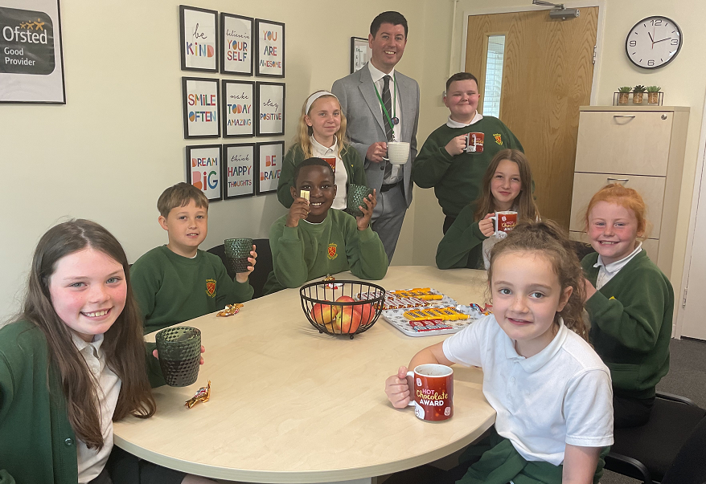

Slide 10
Parent Partnership: How do we involve you?
Meet the Teacher – September 2025
Christmas Performances
Open Evenings
Christmas & Easter Crafternoons
Class Learning Presentations
OPAL Play Dates
Coffee Mornings / Nibble and a Natter
Annual Summer Fair
Raffles & Prizes

Slide 11
Before/After School Care
At Broadway Junior School, we offer a daily Breakfast Club!
A paid for Breakfast Club is available at 7.30am - £3 p/d or £10 p/w.
Our Breakfast Club is free as of 8.00am.
Wraparound Care until 5.00pm (3-4pm = £5 / 3-5pm = £8)

Slide 12
After School Clubs
£5 per half term
Netball
Arts & Craft
Rugby
Mini Warriors
Football
Dance
Cheerleading
Fencing
Basketball
Cookery

Slide 13
Reading
At Broadway Junior School, children are encouraged to develop a love for learning through rich, engaging texts and can access a wide range of quality texts in an engaging learning environment.
Your children access our wide selection of books which are linked to Accelerated Reader. Children are assessed regularly and they can choose from a variety of books at their reading level.
The children will bring books home to share, please make use of our Reading Record Books. Reading with children every day and talking to them about a wide variety of books, helps them to develop a love of books and a varied vocabulary.
There are many things that you can do to support your child at home!

Slide 14
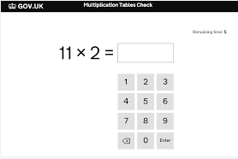
Mathematics
Fluency in number – can children quickly recall number facts, at speed, with ‘automaticity’?
E.G: 3 + 4 = 7 so 30 + 40 = 70 and 300 and 400 = 700
E.G:
2 x 3 = 6 so 6 ÷ 3 = 2
Times Tables – knowing all multiplication facts, by heart, by Year 4 – Multiplication Tables Check (MTC).

Slide 15
Y4 Multiplication
 | MTC Check ‘23 | National Averages | MTC Check ‘24 | National Averages | MTC Check ‘25 (Unvailidated) | National Averages
Av Score | 18.07 | 20.2 | 21.2 | 20.6 | 22.1 | TBC
% (20+) | 44% PP – 45% | - | 70% ↑ PP – 56% ↑ | - | 84% ↑ PP – 85% ↑ | -
% (25) | 20% PP – 19% | 29% | 38% ↑ PP – 34% ↑ | 34% | 54% ↑ PP – 55% ↑ | TBC

Slide 16
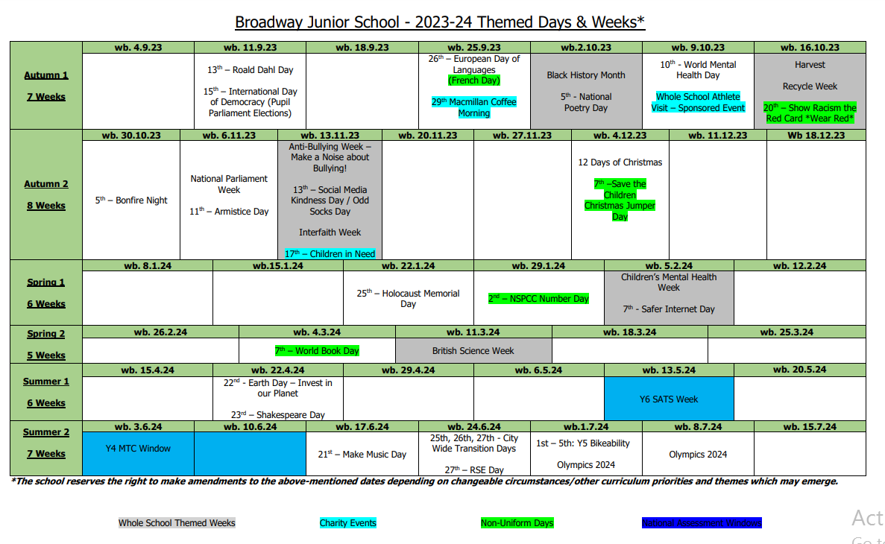
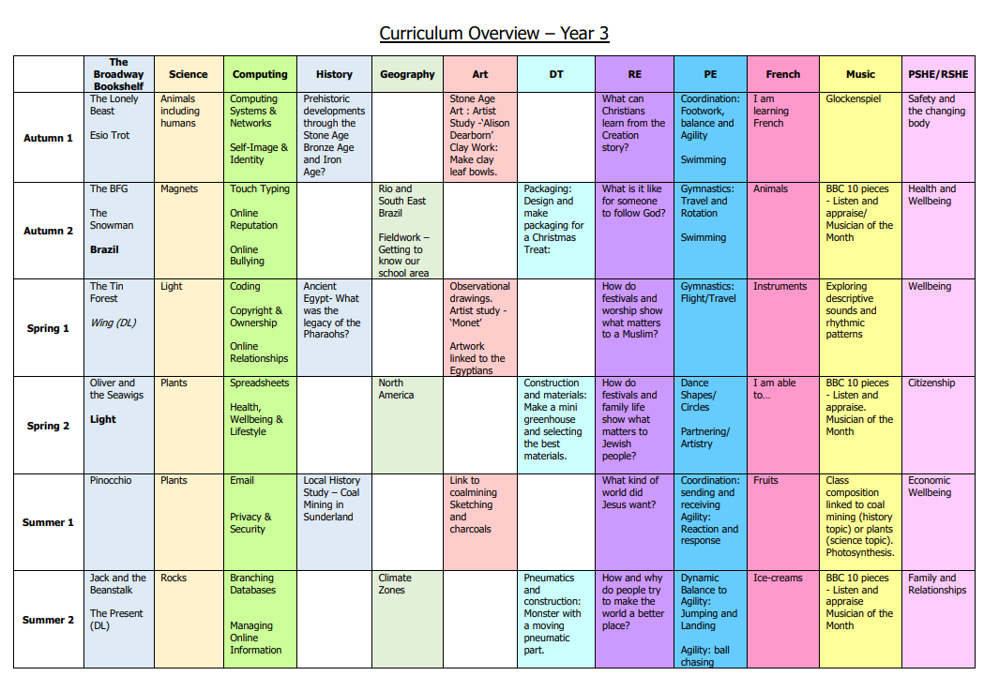
Our Curriculum

Slide 17
Mental Health & Wellbeing

Slide 18
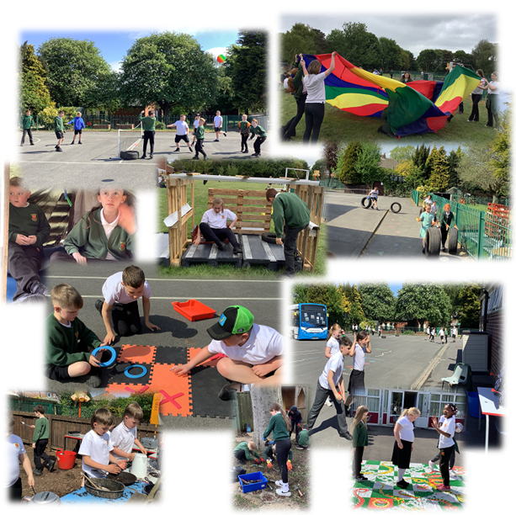
Positive Playtimes
Golden Welly Award

Slide 19
Planned Projects
Full classroom refurbishments – children will return to new furniture and carpets
Classroom ‘cosy corners’
Hall floor refurbishment – a ‘spruce up’
Bus spray painting – linked to our school’s work re. Artsmark
External works
Ongoing partnership with Sir Tom Cowie Trust – funded school visits
This year, we have already refurbished our school library, painted the front of the school, fitted new classroom technology, revitalised and enhanced our play spaces… there’s so much more to come!

Slide 20
Homework
Regular reading
Spellings
Project work
TTRS - https://ttrockstars.com/
Sumdog - https://www.sumdog.com/

Slide 21
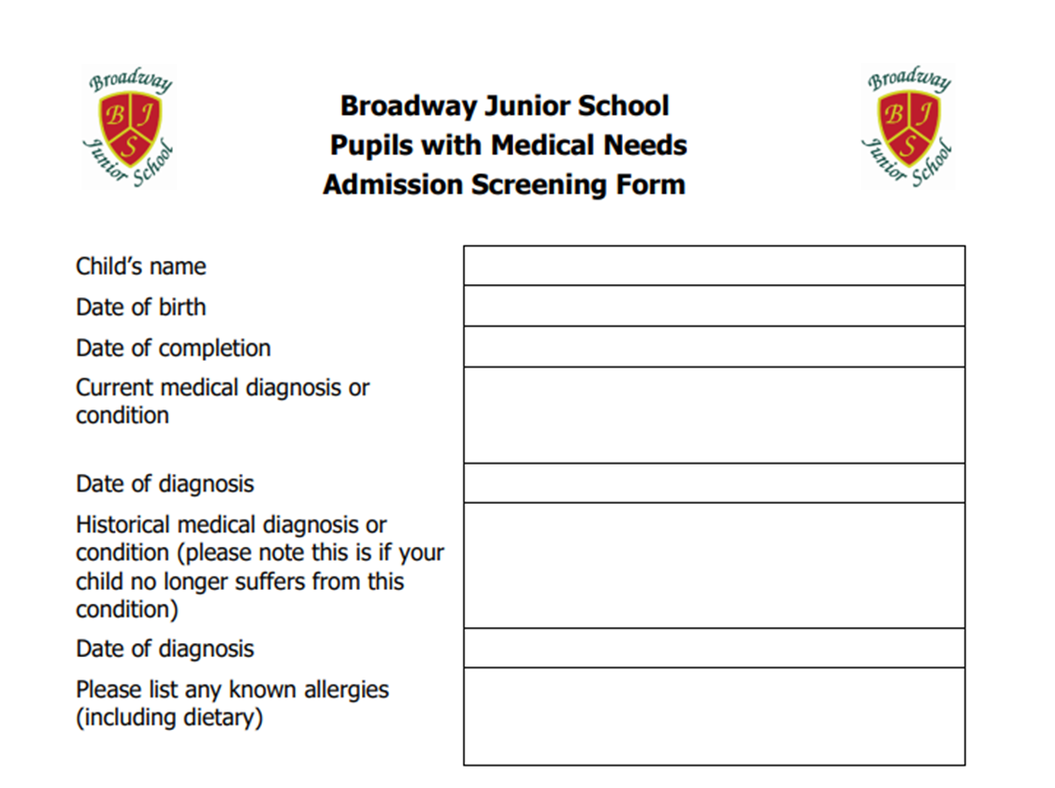
Dinner Money - Online school payment system (SchoolMoney)
If you think that you are entitled to Free School Meals, visit the link in your welcome pack to apply.
Medical needs – Please complete and hand in the form
Key Staff
Deputy Headteacher – Mrs N. Walker
SENDco – Mr D. Ramshaw
Pastoral Support Officer – Jade Hanratty
Office Administration – Mrs. G. Robson

Slide 22
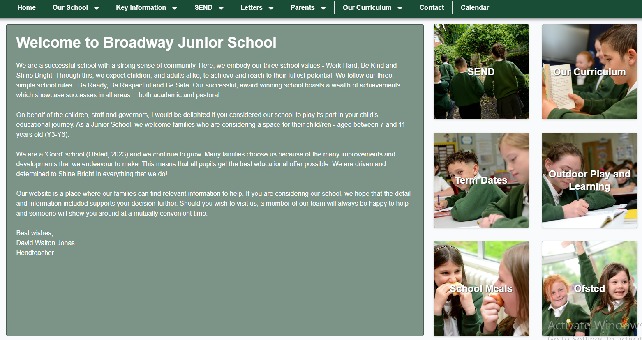
Monthly Newsletters: Broadway Bulletin
Website: www.broadwayjuniorschool.com
Follow us on Twitter (X): @BroadwayJuniors
Year3@broadwayjuniorschool.com

Slide 23
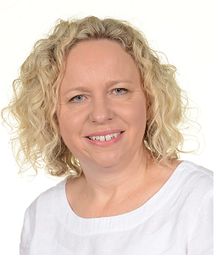
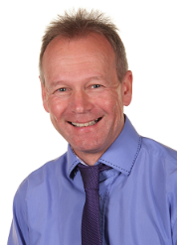
Class Arrangements
September 2025
Mrs Hastie
Mr McCabe

Slide 24
Safeguarding Leads

Slide 25
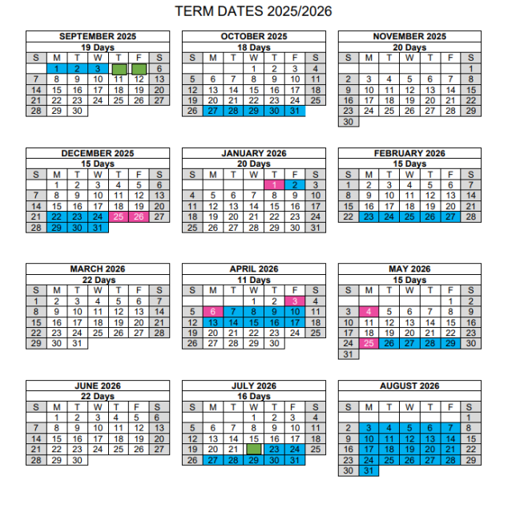
Children return to school on Monday 8th September 2025
POLITE REMINDER: Key contact – admin@broadwayjuniorschool.com
Please provide us with sight of your child’s birth certificate, or passport, in person or via email.

