Slide 1
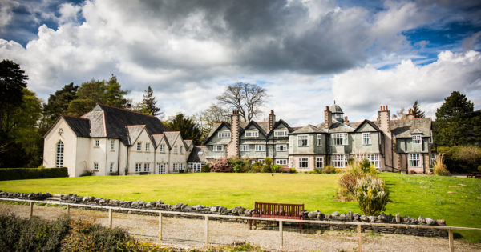
Derwent Hill
Monday 29th September – Friday 3rd October 2025

Slide 2
Pick up and Journey
Drop off on Monday morning at 9:15am. Meet outside of school next to bus stop.
Children to give case to a member of staff who will put it on board. They will get straight on the bus.
Parents should avoid blocking path and find somewhere to wait away from bus.
Children can bring a small backpack to keep on the bus with them. They can bring a book or travel game, etc. to keep them amused (nothing electronic!) plus a small snack and a drink.
Children will eat lunch on arrival. Derwent Hill will provide this.
All medication to be handed to Miss Taylor by Friday 26th September.
Any new medication – please stay behind and we will chat to you at the end.

Slide 3
Friday Collection
The party will arrive back at school on Friday 3RD October.
We anticipate returning to school at approx. 3:30pm although a text message will be sent approximately 40 minutes before arrival.
Please collect your child from the Springwell Road bus stop.

Slide 4
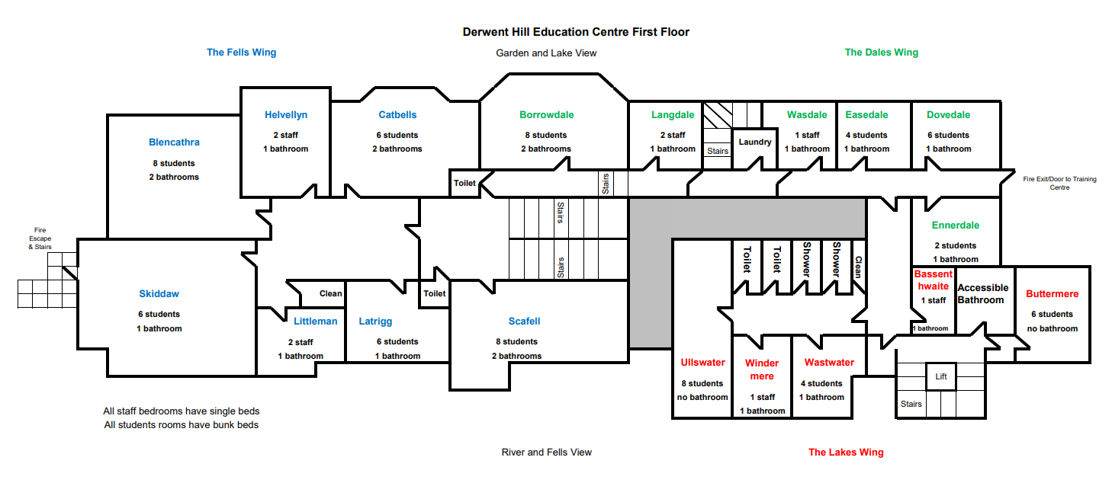

Slide 5
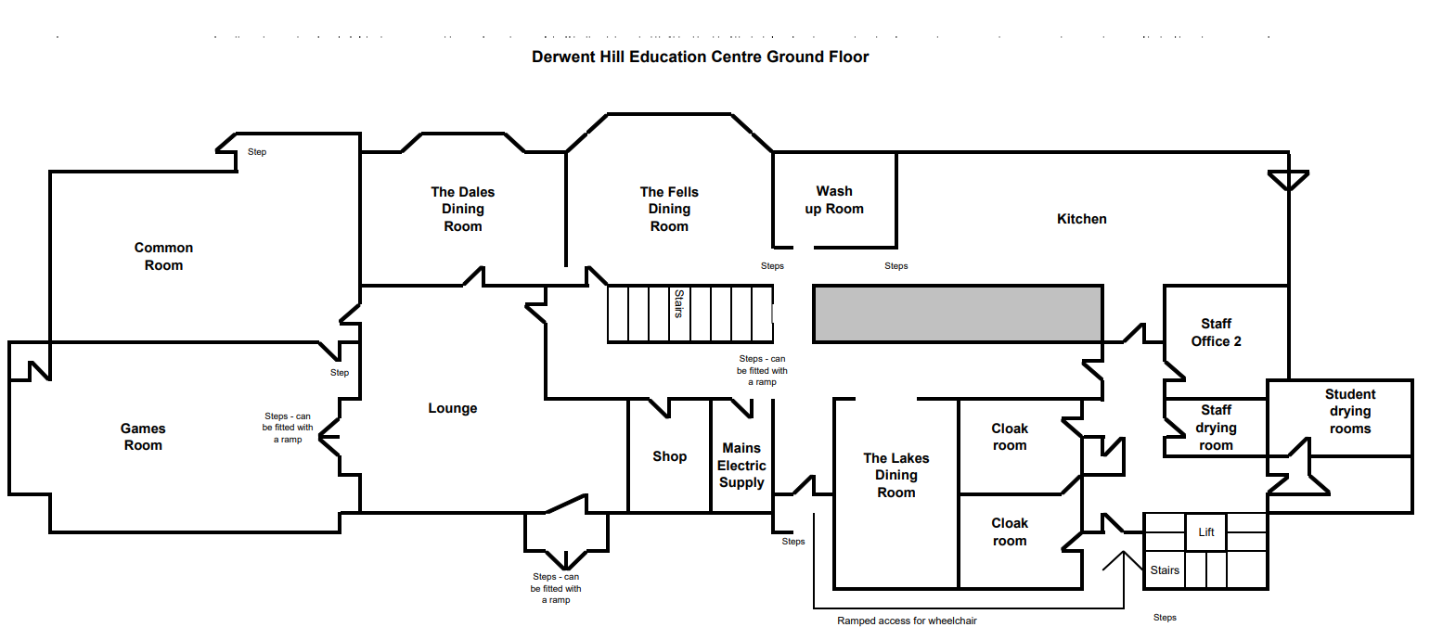
Downstairs

Slide 6
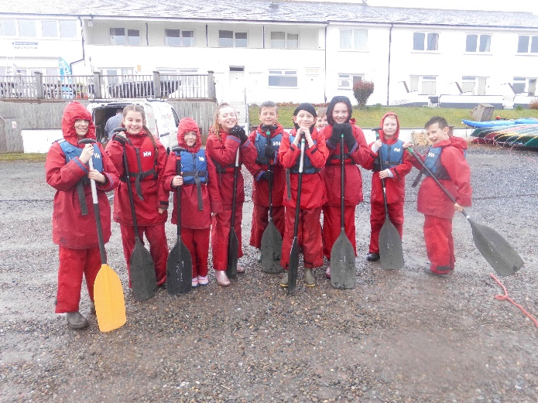
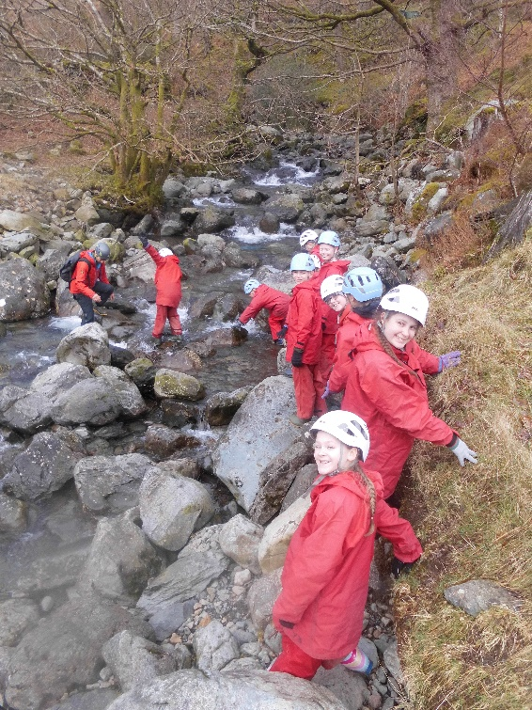
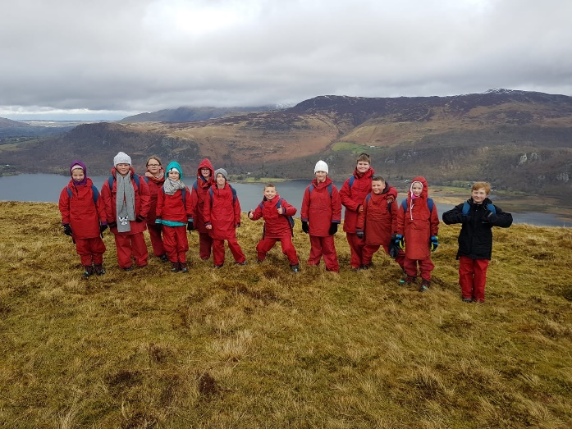
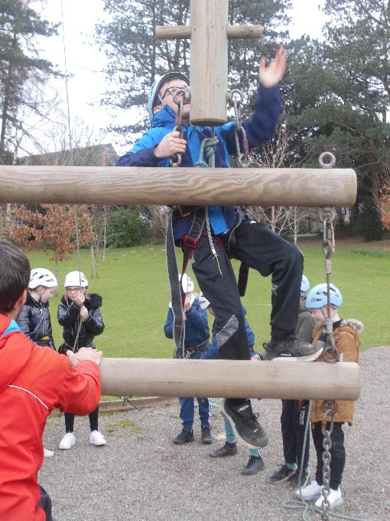
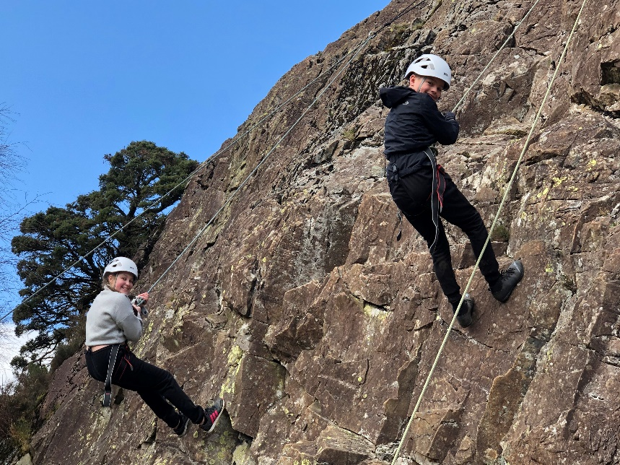
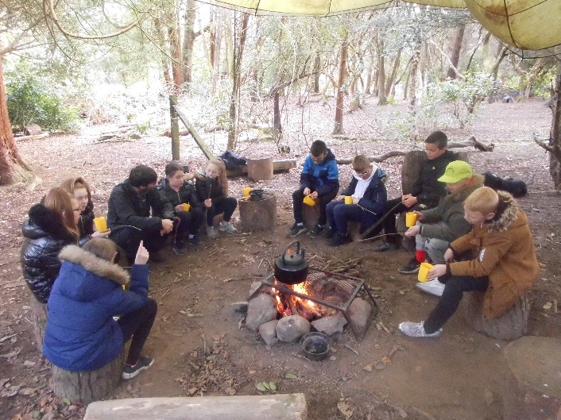
Activities

Slide 7
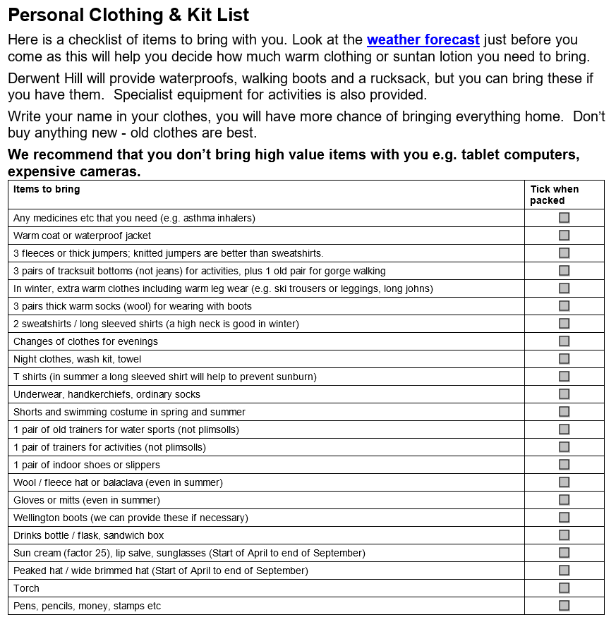
Also useful:
Dirty clothes bags
Pocket money (up to £10.00) – children are responsible for this
Sun cream
Names in/on everything!
Things to avoid:
No electronic devices
No false nails/jewellery

Slide 8
Any Questions?

