Slide 1


Meet the Teacher
Year 3

Slide 2
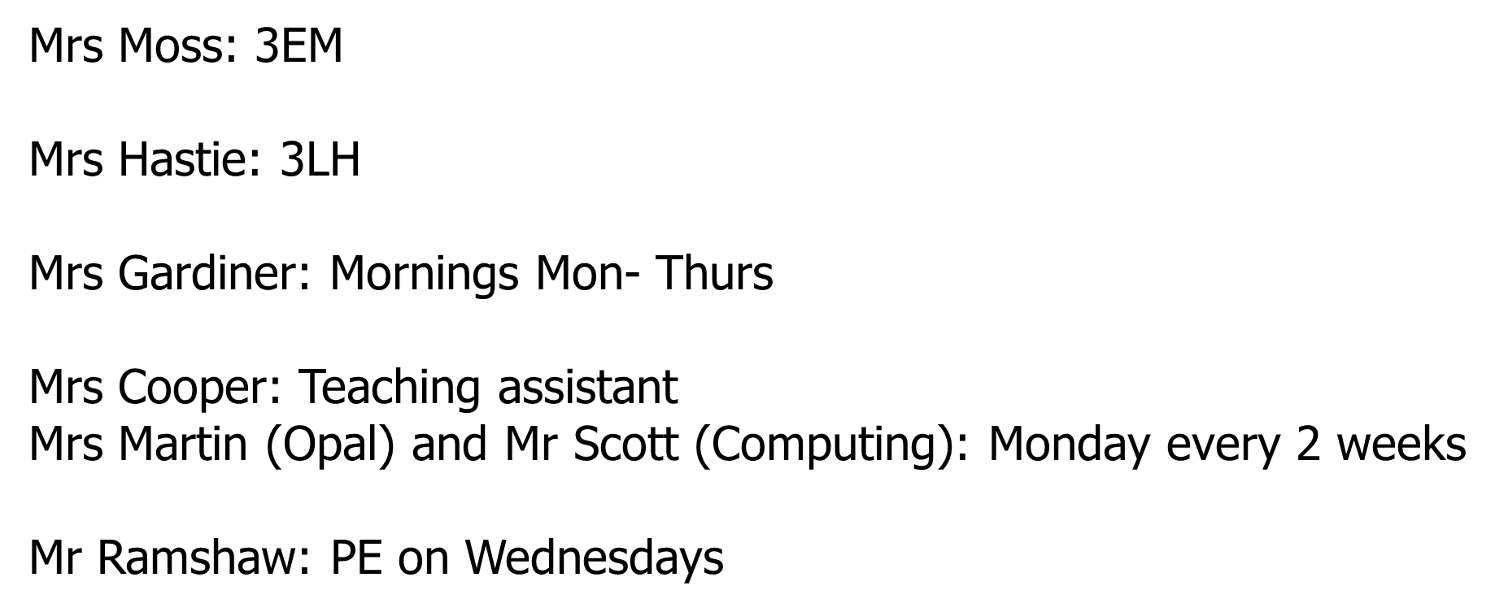
Year 3 Staff

Slide 3

Values and Vision
At Broadway, our core values are:
OPPORTUNITY to flourish
ACHIEVEMENT for life
WELLBEING for all.
The children are at the very heart of our vision, our aims, our hopes and our expectations. We work hard to give every child a wide range of exciting opportunities and experiences throughout their four years with us, promoting their personal, social and cultural development and helping them to flourish and thrive in a 21st century world.

Slide 4
Uniform
Attendance
Behaviour expectations
Reading
Mathematics
Homework
Curriculum
Curriculum enrichment
Careers Curriculum
RHE Curriculum Updates
Five Ways to wellbeing
My Happy Mind
Important dates
Fab Marking
Key Staff
Communication

Slide 5
Uniform
At Broadway, we expect all children to wear school uniform as it promotes a sense of identity and pride in our school and helps all children feel equal. Our uniform is designed to be practical, comfortable, affordable, hard-wearing and easy to wash.
Uniform is as follows:
Bottle green sweatshirt/cardigan (branded/unbranded)
White polo shirt (branded/unbranded)
Black flat shoes or trainers (must be all black)
Charcoal grey/black school skirt, pinafore or smart tailored school trousers
In the Summer:
Green and white checked dress
Charcoal grey/black school shorts
PE Uniform:
Green sports top (available branded/unbranded)
Green quarter zip top (available branded/unbranded)
Black joggers/shorts
Black Trainers
Children can come to school on their PE day wearing their PE kit
School operates a strict no-jewellery policy.

Slide 6
Attendance
Having a good education will help to give your child the best possible start in life and as you will already be aware, we expect regular and punctual attendance at school. It is recognised that poor school attendance limits educational achievement and the future progress of young people.
Our goal is for all pupils to meet a target of 97 - 100% attendance.
You can help us by:
Encouraging your child to attend school punctually.
Telephoning on the day of an absence and providing information to explain the absence on your child’s return to school.

Slide 7






Behaviour Expectations
At Broadway Junior School we ensure that every member of the school community feels valued and respected, and that each person is treated fairly and well. The school Behaviour Policy is therefore designed to support the way in which all members of the school can work together. It aims to promote an environment where everyone feels happy, safe and secure.
Every child has a peg on the behaviour chart and can move up or down depending on their behaviour and attitude.
The children are awarded positive points when they demonstrate our School Motto
The children collect these points and will be awarded certificates in our celebration assembly each week: Bronze for 25 positive points, Silver for 50 positive points, Gold for 75 positive points and platinum for 100 positive points. Children who receive a warning may miss some minutes of their outdoor time.

Slide 8
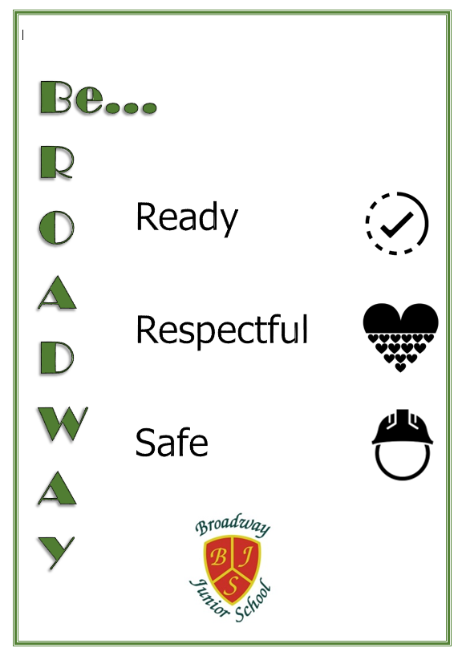
Our school rules

Slide 9
Reading
At Broadway Junior School, children are encouraged to develop a love for learning through rich, engaging texts and can access a wide range of quality texts in an engaging learning environment.
Your children access our wide selection of books which are linked to Accelerated Reader. Children are assessed regularly and they can choose from a variety of books at their reading level.
In order to reinforce learning, your child will be given a reading record book. Reading is exceptionally important and it is imperative that children are reading regularly, hopefully for 10 – 15 minutes at least 5 times per week at home. It would be really helpful if you could listen to your child read and record this in their home reading record. Reading records are to be returned every Monday morning.
Children will bring a book home from school, but they are also quite welcome to read any books or magazines they have at home. Reading with children every day and talking to them about a wide variety of books, helps them to develop a love of books and a varied vocabulary.

Slide 10
Things you can do to support your child at home.
Look at the book first, talking about what you can see happening in the pictures.
Try to predict the story and possible unknown words.
Your child will know how to blend sounds when reading. However, words such as was are a little trickier as sounding them out does not work. The children just need to learn how they look.
Look out for words they already know within longer words eg: dustbin.
Remind children to think about how speech might be said to encourage them to read with expression.
Punctuation helps your child to read with intonation and brings a book to life.
Question your child about events in the book to check that they have understood what they are reading.
Encourage your child to refer to words and passages in the text to justify opinions

Slide 11

Reading

Slide 12
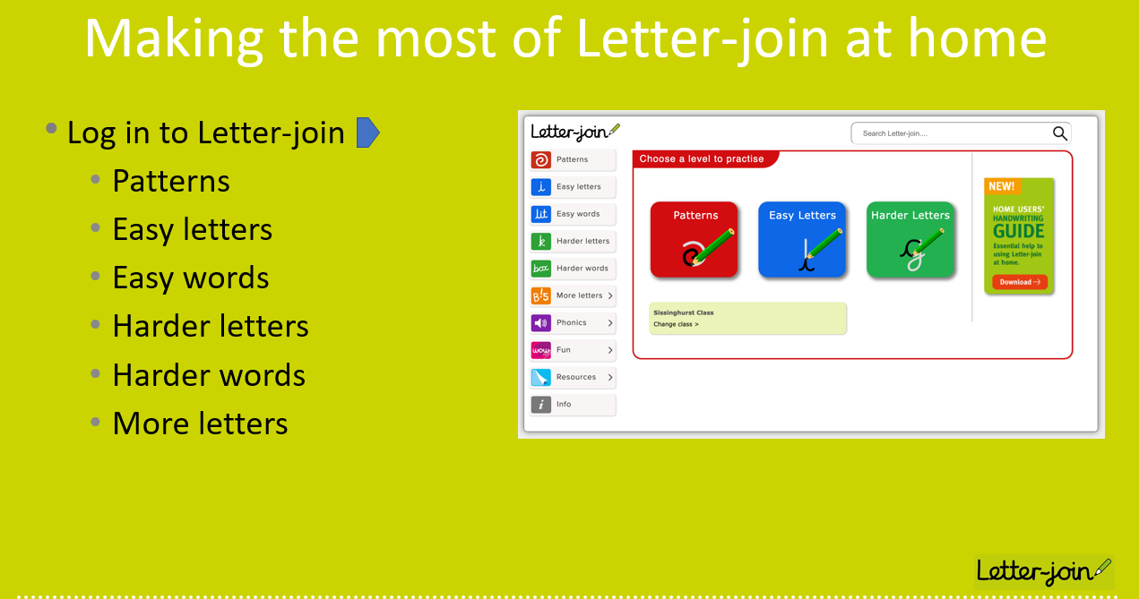
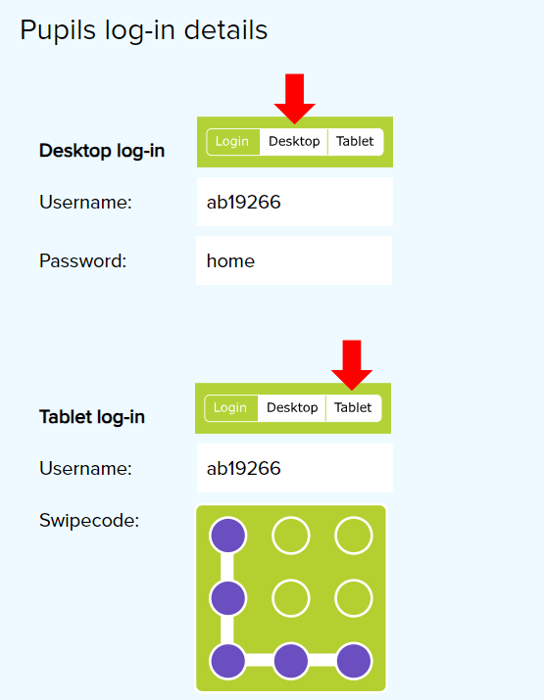
Handwriting

Slide 13

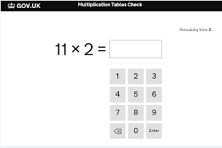
Mathematics
Fluency in number – can children quickly recall number facts, at speed, with ‘automaticity’?
E.G: 3 + 4 = 7 so 30 + 40 = 70 and 300 and 400 = 700
E.G:
2 x 3 = 6 so
6 ÷ 3 = 2
Times Tables – knowing all multiplication facts, by heart, by Year 4 – Multiplication Tables Check (MTC).

Slide 14
Homework
Children will receive homework each Monday to be returned the following Monday. Homework may be set using an online platform
Spellings
Project work
TTRS - https://ttrockstars.com/
Purple mash - https://www.purplemash.com/

Slide 15
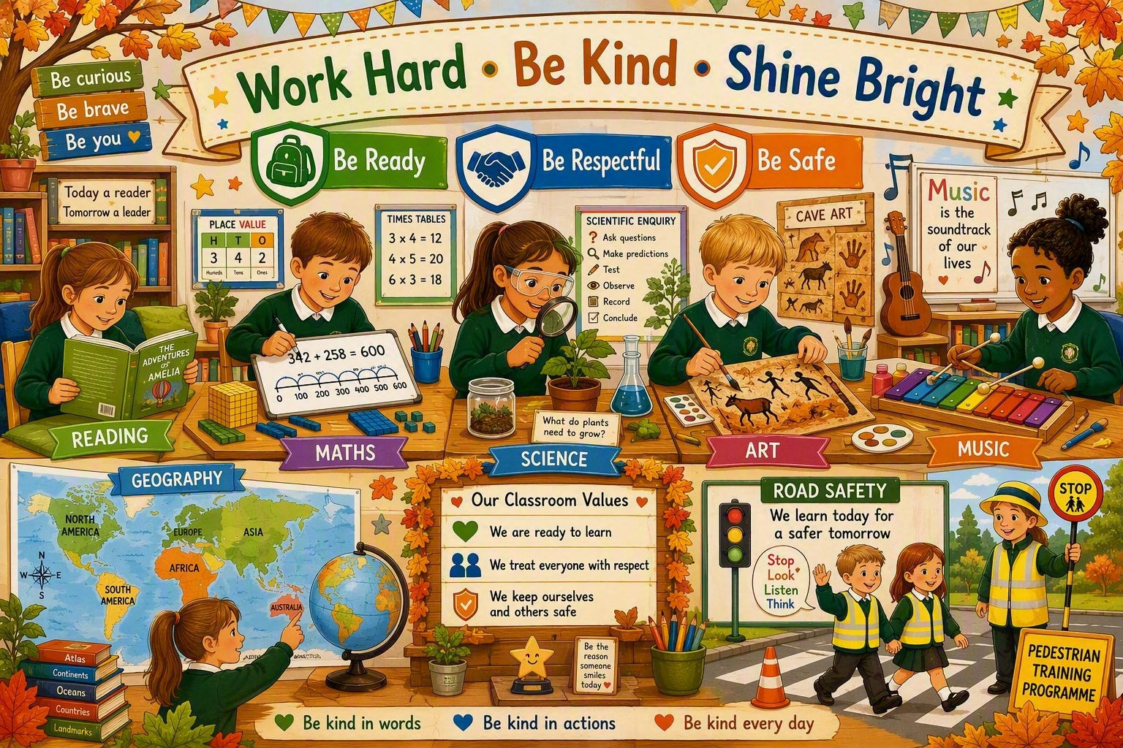
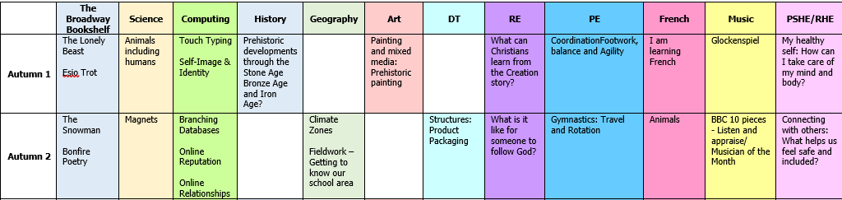
Curriculum

Slide 16


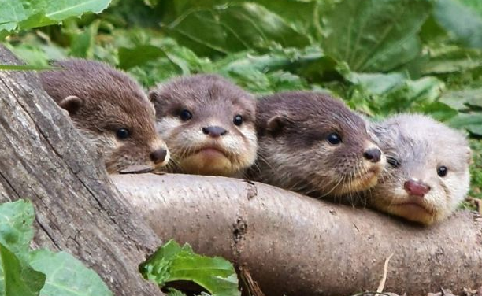

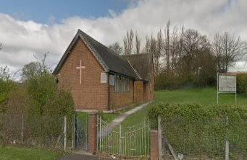
Curriculum enrichment
Washington Wetlands
Tuesday 29th September
Tuesday 6th October

Slide 17
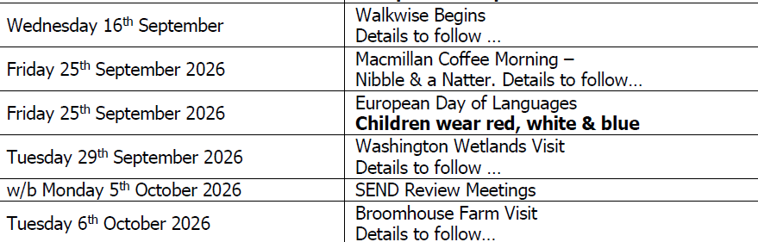
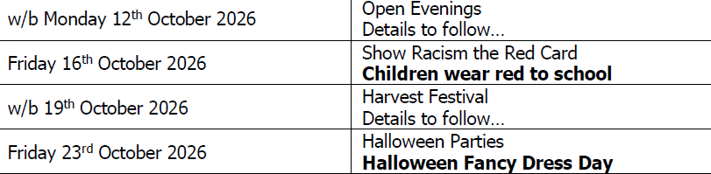
Diary dates

Slide 18
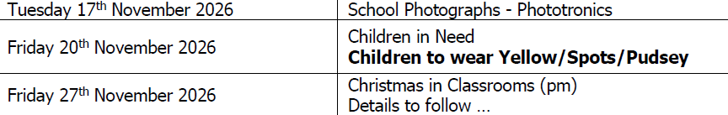
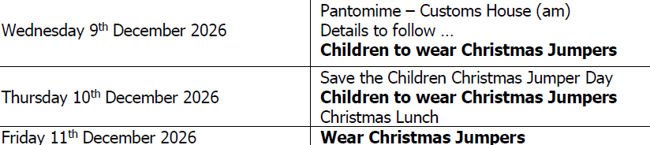
Diary dates

Slide 19

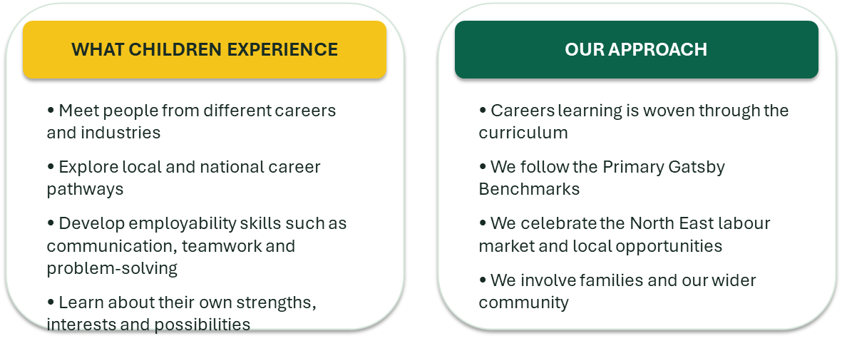

Careers Curriculum
Broadens children’s horizons and raises aspirations
• Challenges stereotypes about jobs and who can do them
• Helps children connect learning in school with real life
• Builds confidence, curiosity and ambition
Every child deserves to see a future they can believe in — and know how to work towards it.

Slide 20
RHE Curriculum Updates
Relationships & Health Education at Broadway Junior School
We are pleased to share some updates to our Relationships & Health Education (RHE) curriculum. We have reviewed and developed our curriculum to ensure that it continues to meet the needs of our pupils and provides them with the knowledge, understanding and skills they need to stay safe, healthy and confident as they grow.
What is changing?
Our updated curriculum has a focus on:
Healthy and positive relationships – understanding friendship, kindness, respect and how to manage disagreements.
Emotional wellbeing – recognising and talking about feelings, developing resilience and knowing when to ask for help.
Keeping safe – understanding personal boundaries, privacy, trusted adults and how to respond when something doesn't feel right.
Growing and changing – age-appropriate learning about how our bodies and feelings change as we grow.
Online safety – making safe choices online and understanding how our actions and communication can affect others.
Respect and consent – developing an understanding of personal space, boundaries and respecting the choices of ourselves and others.
Healthy lifestyles – learning about physical health, hygiene, exercise, sleep, nutrition and looking after our overall wellbeing.
Why are we making these changes?
Children are growing up in an increasingly complex world. We want our pupils to have the language, knowledge and confidence to make safe and healthy choices, build positive relationships and seek support when they need it.
Our RHE curriculum is carefully planned and age-appropriate, with learning building progressively throughout Key Stage 2. We will always approach sensitive topics in a respectful and appropriate way.
Working together with families
Parents and carers play an incredibly important role in helping children develop these skills. We will continue to keep parents informed about the curriculum.
Our aim is simple: to help every child understand themselves, respect others, stay safe and feel confident about growing up.

Slide 21

5 Ways to Wellbeing

Slide 22

My Happy Mind
Mindfulness Mondays
https://www.youtube.com/watch?v=pmjYmaj8cpw

Slide 23

Celebration Assembly

Slide 24

FAB Marking

Slide 25
Key Staff
Dinner Money - Online school payment system (Arbor)
Medical needs – Please ensure that you have informed school and updated any documentation including any allergy information.
Key Staff
SENDCo – Mr D Ramshaw
Pastoral Support Officer – Jade Hanratty
School Business Manager- Mrs K Oliver
Office Administration - Mrs G Robson

Slide 26
Communication
Regular newsletters : Broadway Bulletin
Website: broadwayjuniorschool.com
Email. admin@broadwayjunior.org.uk
Follow us on Facebook – Coming Soon!

